Slide 1
Projet Transversal VIP
Introduction et nouvelles
Sorina Pop
6ème Workshop VIP
03/06/2018

Slide 2
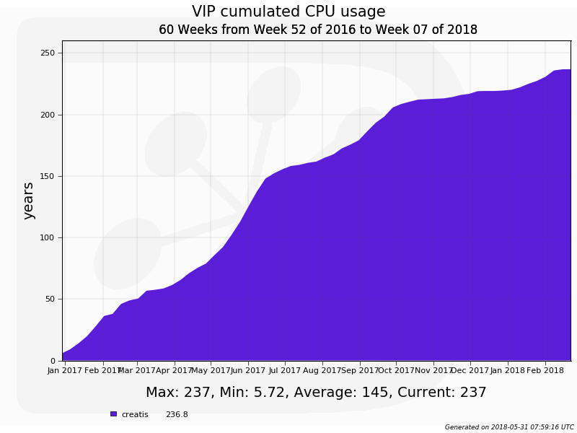
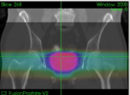
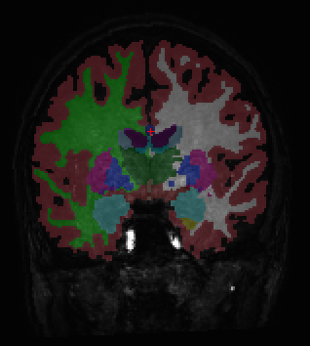
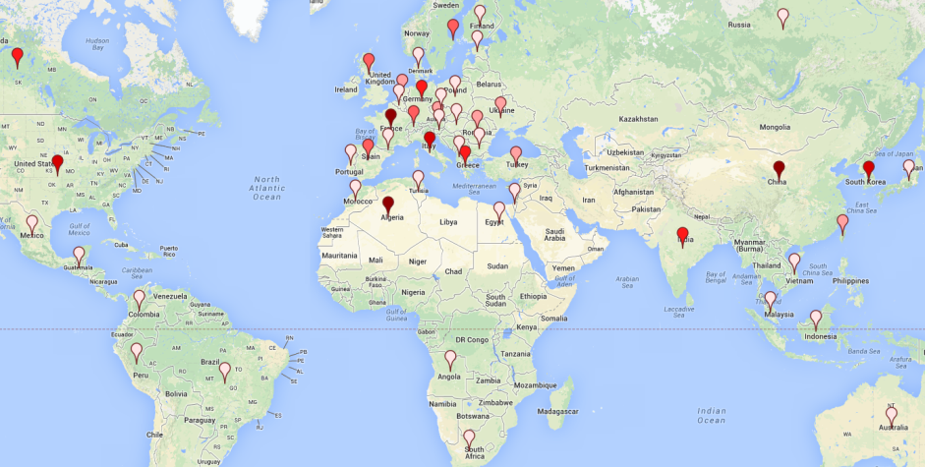
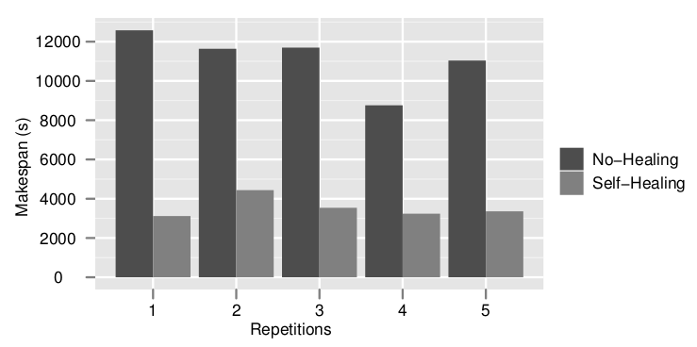
https://vip.creatis.insa-lyon.fr
Web portal
Infrastructure
Application as a service
File transfer to/from grid
Supported by EGI Infrastructure
Uses biomed VO (~65 sites in Europe and beyond)
VIP consumes ~20 CPU years every month
France-Grilles
Scientific applications
Cancer therapy simulation
Neuro-image analysis
DIRAC
Users
1000+ registered users in June 2018
55 publications since 2011
Prostate radiotherapy plan simulated
with GATE(L. Grevillot and D. Sarrut)
Brain tissue segmentation
with Freesurfer
Image simulation
Modeling and optimization of
distributed computing systems
Echocardiography simulated with
FIELD-II (O. Bernard et al)
Acceleration yielded by non-clairvoyant
task replication (R. Ferreira da Silva et al)

Slide 3
Why use VIP?
To get/give access to medical imaging applications
No need for installation on the users’ side
Easy to use
To share
Applications and data
To get access to distributed computing and storage resources
« Free » of charge for research usage
Moral obligation to report publications using these resources

Slide 4
VIP transverse project latest actions
VIP software development
VIP version 1.24 released on March 22nd (https://github.com/virtual-imaging-platform/VIP-portal/releases/tag/1.24)
Possibility to "publish" pipelines to Zenodo and get a DOI (using Boutiques BOSH publish)
Migration from the LFC to Dirac File Catalog
Upgraded smartgwt
VIP – Projet GATE OpenDose
See Gilles’ presentation
Communication
EGI conference in Amsterdam: keynote, two presentations and a poster
MIPRO conference in Croatia: Exploiting GPUs on distributed infrastructures for medical imaging applications with VIP and DIRAC
Two EGI articles
https://www.egi.eu/use-cases/research-stories/creating-a-digital-heart
https://www.egi.eu/wp-content/uploads/2019/04/Inspired_Issue_34.pdf

Slide 5
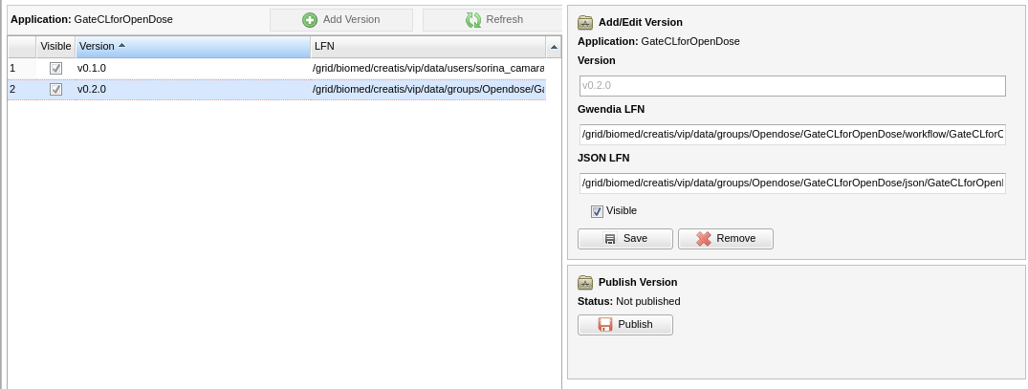
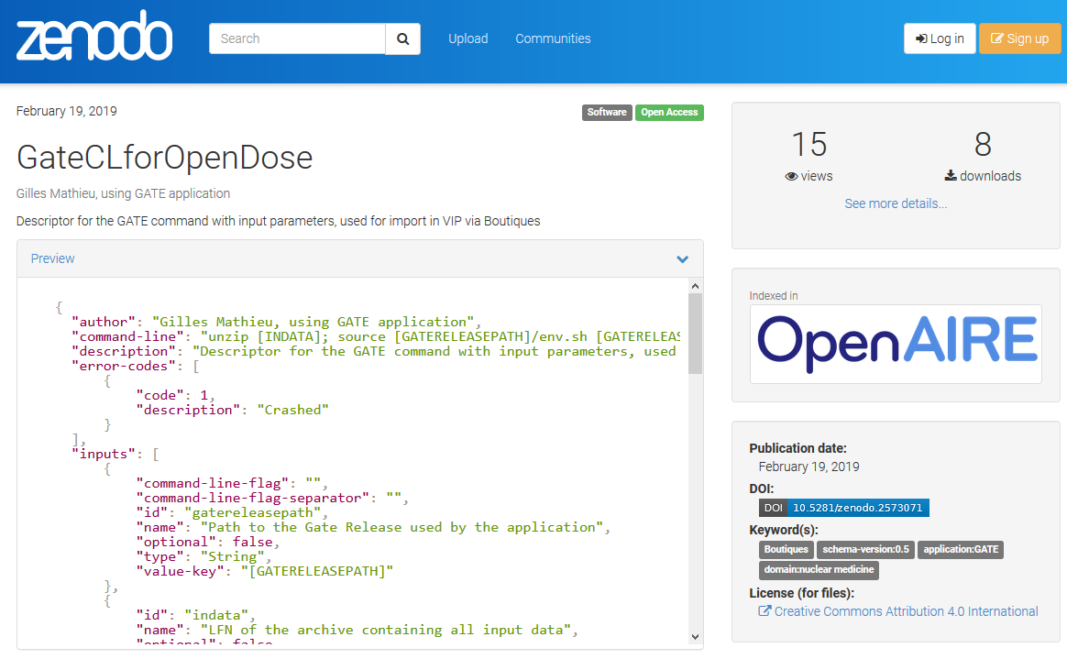
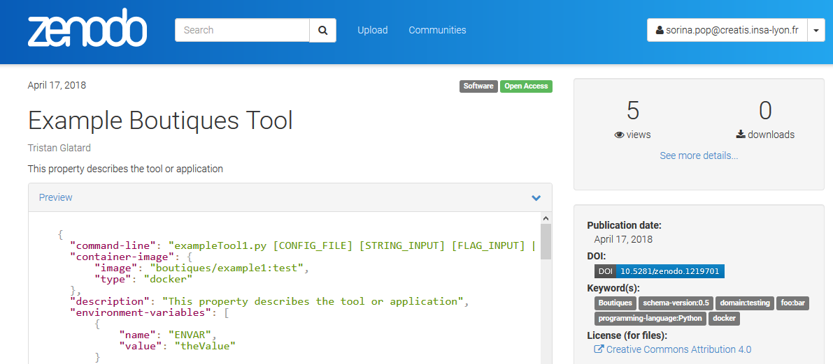
Application publishing in VIP with Boutiques
Share your tools in a packaged and fully described fashion
Boutiques publishes descriptors to Zenodo (https://zenodo.org)

Slide 6
Future plans
Follow-up on GPU integration
Interoperability with various databases (see Axel’s presentation)
Integrate visualization tools (discussion to follow)
Submitted “FAIR LADI” proposal to ANR Flash “Open Science”
FAIR (Findable, Accessible, Interoperable, Re-usable) data analysis
IR position open for the 2019 CNRS recruiting campaign

Slide 7
Programme
Introduction et nouvelles de VIP (Sorina)
CARMIN, VIP et les bases de données – Girder (Axel)
Simulations de dosimétrie sur la grille via VIP/CARMIN : retour d'expérience (Gilles Mathieu, Inserm)
Implémentation sur VIP d'une méthode de synthèse de pseudo-CT (Frédéric)
Qu'en est-il de la Visu dans VIP ? (Sorina)
Tour de table

