Slide 1
Reconstruction TomoDensitoMétrique
conique 4D

Slide 2
Contexte
Interventionnel cardiaque: objectifs
Imagerie fonctionnelle : détection d’hypo/a-kynésie, mesure de la fraction d’éjection
Guidage des interventions pour utiliser moins d’iode (électrophysiologie, remplacement de valve aortique, angioplastie)
Radiothérapie du poumon: objectifs
Réduire les marges de traitement
Comparer mouvement du jour et mouvement de planning
Calculer la dose reçue à posteriori

Slide 3
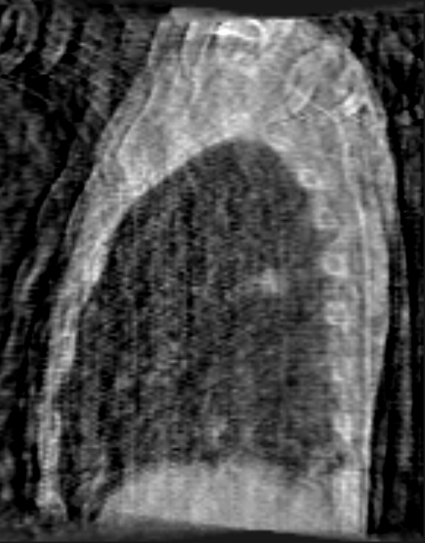
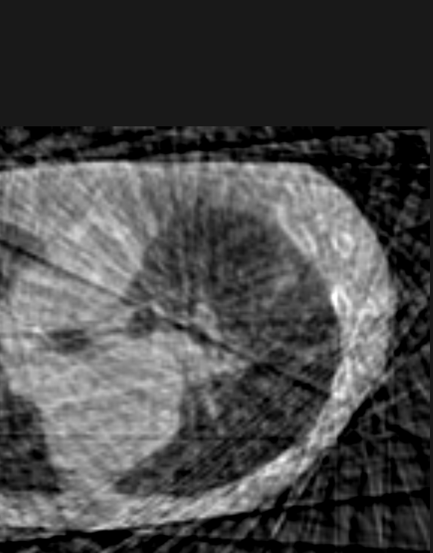
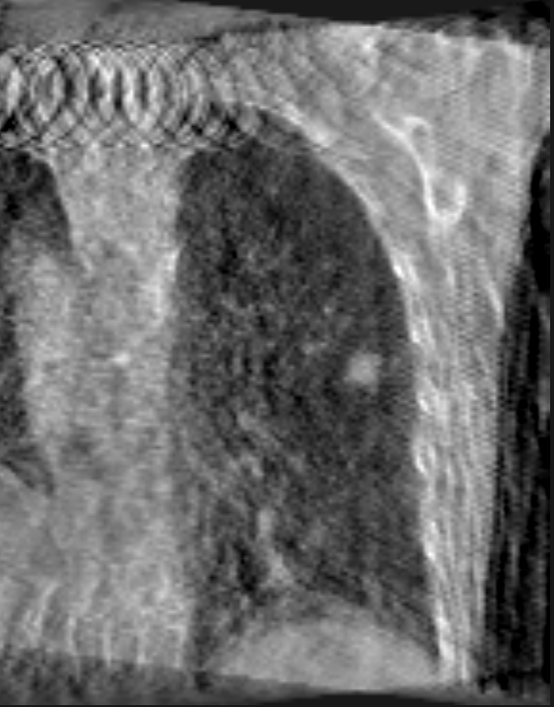
Verrous
Mouvement
=> Synchronisation (ECG ou signal respiratoire)
=> Peu de projections, mal réparties sur l’espace angulaire
=> Artéfacts

Slide 4
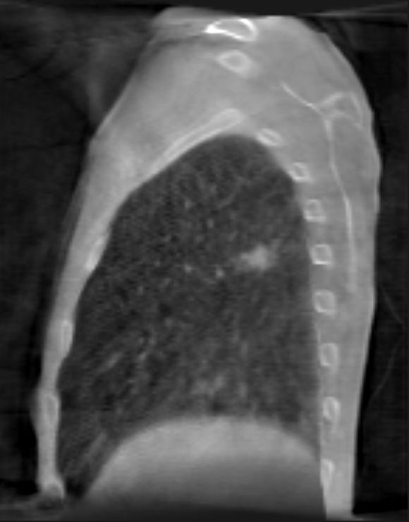
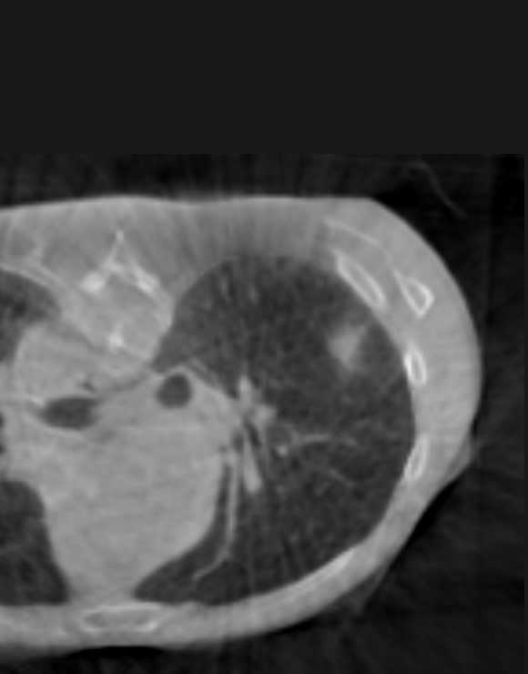
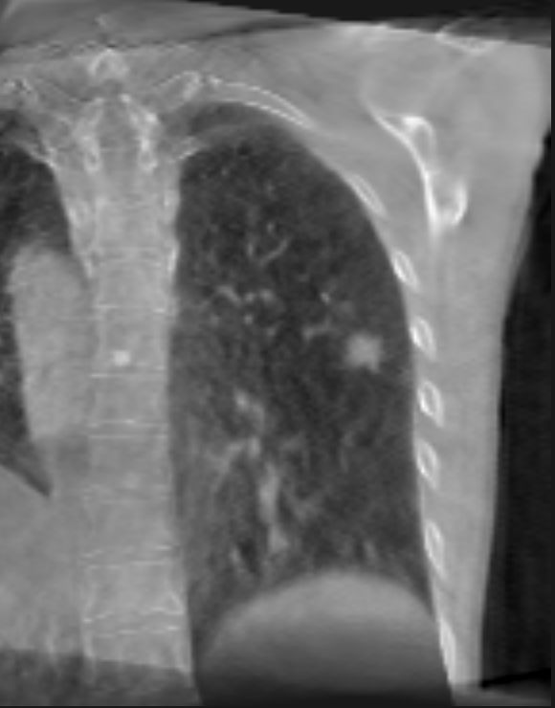
Méthodes : Compensation de mouvement
Recalage déformable 3D/3D
Estimation sur CT de planning
Reconstruction des projections coniques avec le mouvement du CT de planning
Recalage déformable 2D/3D
Estimation sur projections coniques et CT de planning
Reconstruction des projections coniques avec ce mouvement

Slide 5
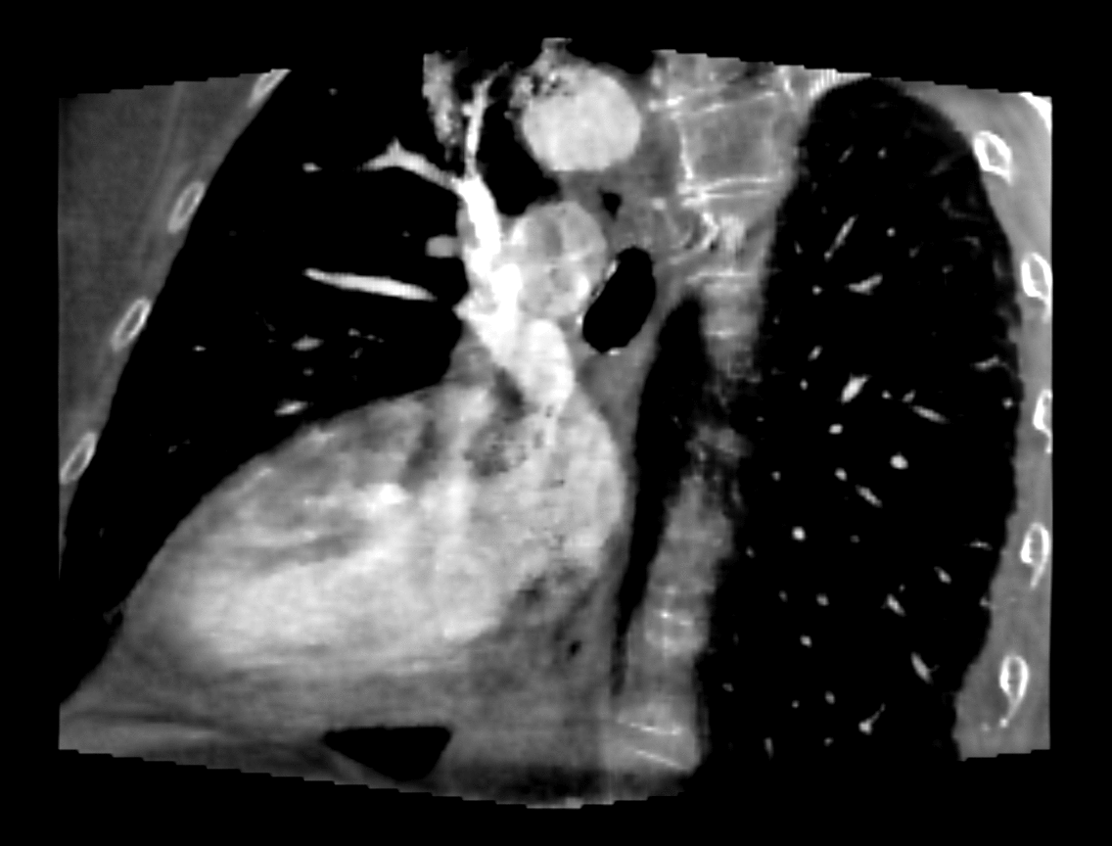
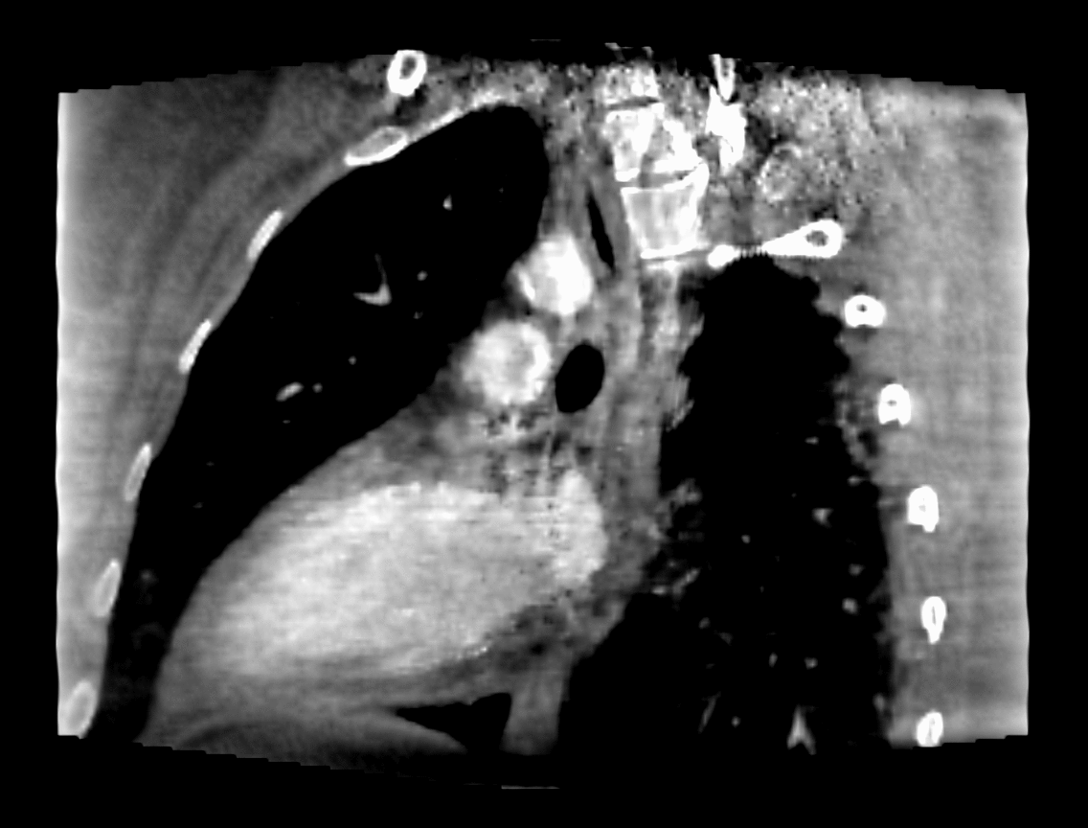
Méthodes : Optimisation convexe régularisée
Reconstruction 4D régularisée
Intégralité des projections coniques
Manque d’information pour chaque phase compensé par des étapes de régularisation
Variation totale spatiale
Variation totale temporelle
Autres (positivité, support, masque de mouvement, …)
Méthode initialement développée pour le cœur

Slide 6
Algorithme 4D compressed sensing
4D ROOSTER [Mory, MedPhys 2014]
4D RecOnstructiOn using Spatial and TEmporal Regularization
For iter = 1 to max_iter
Conjugate gradient on
Positivity enforcement
Averaging along time outside ROI
Spatial TV minimization
Temporal TV minimization
Notes:
So here it is, this is the method I’ve proposed in a paper recently published in Medical Physics. It’s called 4D Reconstruction using spatial and temporal regularization, short 4D ROOSTER, so it’s a very French method, and instead of defining a cost function and minimizing it, it alternates between different optimization goals to enforce several constraints.
As in the previous method, the estimate f is a 4D sequence of volumes. The first step of the algorithm is a conjugate gradient descent to minimize the data attachment term (which is the same as in the previous method). The result of this conjugate gradient highly depends on the starting point (with the data-attachment term under this form, it is hard to talk about the kernel of a linear operator, but just consider we’re reconstructing 10 volumes with enough data for one, so the system is underdetermined), so we have to apply the other constraints to move this starting point, and loop several times.
The other constraints are :
positivity : we just set all the negative voxels to zero
No movement outside the segmentation of the heart : we average the voxels along time outside the ROI
Spatial TV minimization
Temporal TV minimization, both using a simple steepest descent approach, with a data-attachment term (to avoid ending up with a flat image)
There are many advantages to this approach, and one major drawback. So first, the drawback: it is hard to prove that this algorithm converges. But using the theory of non-expansive mappings, I did prove that if it has at least one fixed point, it does converge. Whether it does have a fixed point, that’s another question.
Now for the benefits:
It is easy to enforce only a subset of the constraints, in order to observe the effect of each constraint and fine-tune it
The constraints are, to a large extent, indenpendant, and can be tuned one by one
It would be easy to add constraints
Now let’s look at the results

Slide 7
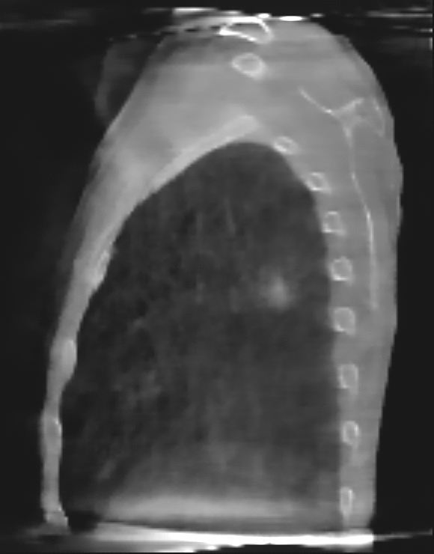
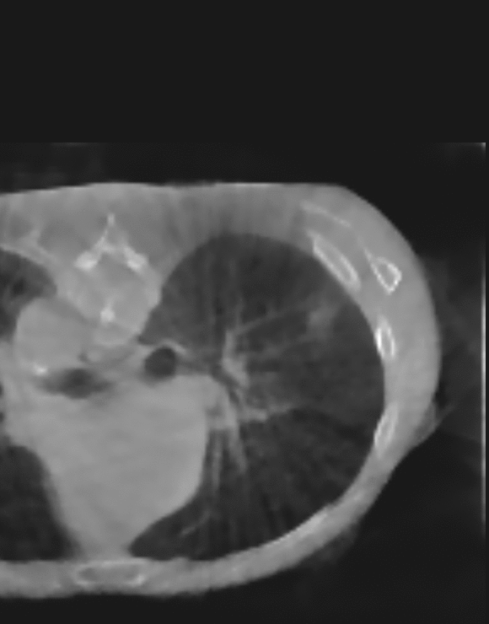
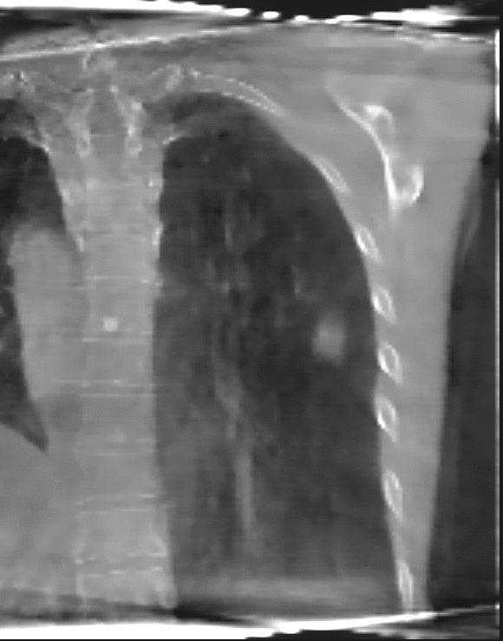
Méthodes : Optimisation convexe régularisée
Application au poumon
Mouvement plus ample
Pas d’iode => contraste réduit
=> Flou dans les zones en mouvement
=> Nécessité d’adapter la méthode

Slide 8
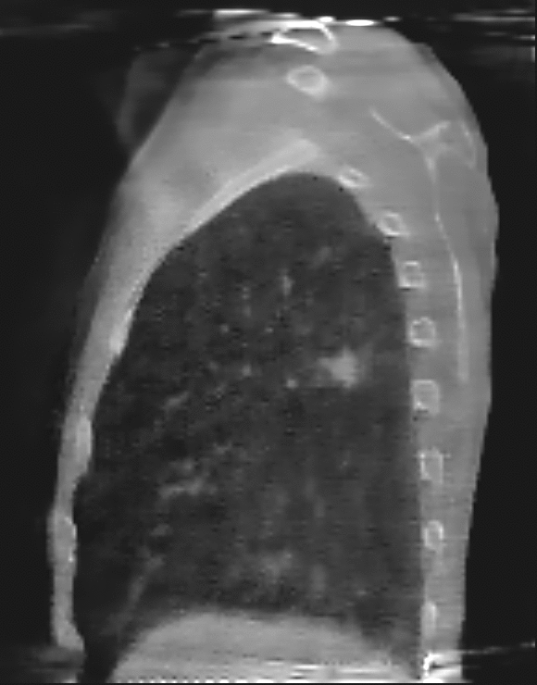
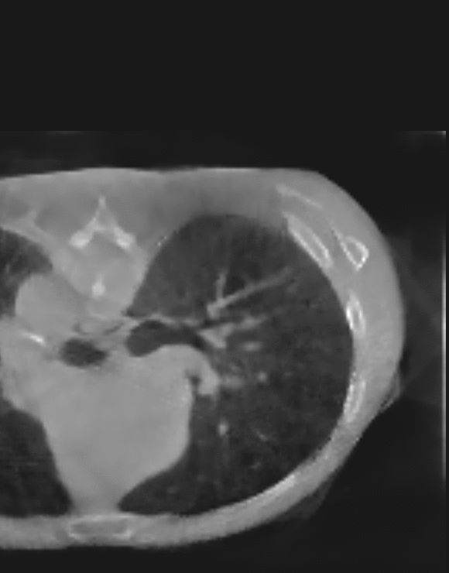
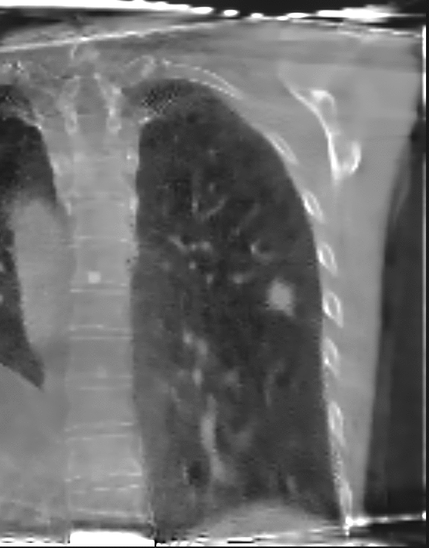
Méthodes : Approche mixte
Reconstruction 4D par optimisation convexe + compensation de mouvement
Régularisation spatiale identique
Régularisation temporelle intégrant un champ de mouvement
Autres contraintes identiques

