Slide 1
X-ray Phase CT

Slide 2
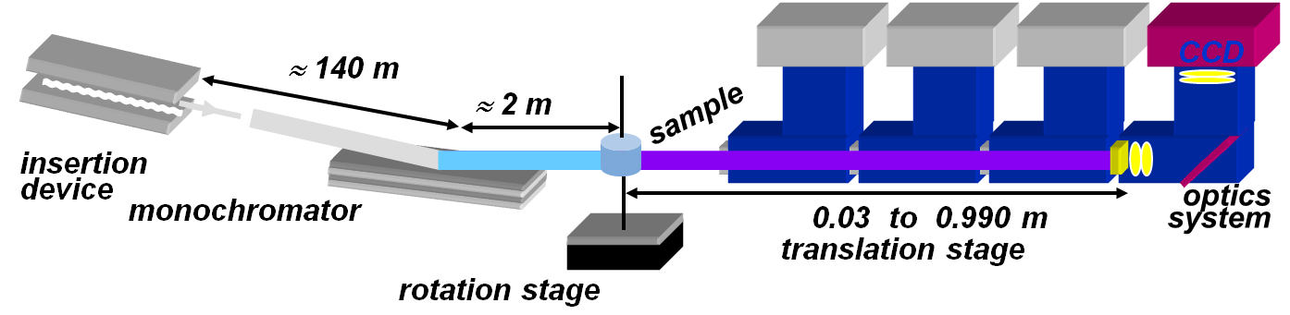


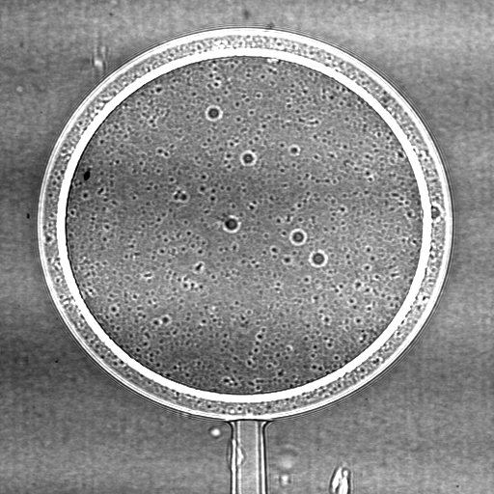
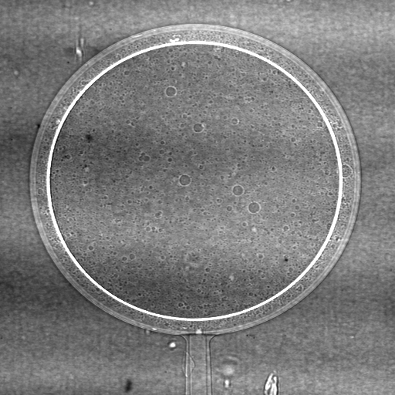
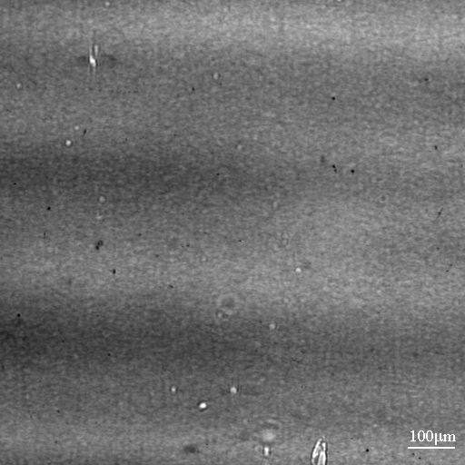
X-ray phase contrast Phase tomography
Free space propagation is the simplest phase contrast mechanism
Several orders of magnitude increase in sensitivity
Inverse problem to be solved
  Direct problem
  Phase retrieval : find ϕ from Id(x)
  Phase CT : Tomographic reconstruction of δ
Aim: improve resolution, alleviate Low Frequency noise
Coherent X-rays
850 µm
Polystyrene (30 µm)
Parylene (15 µm)
E=20.5 keV

Slide 3
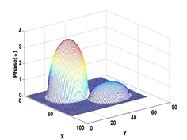
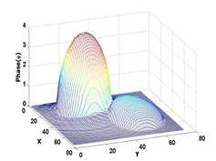
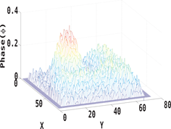
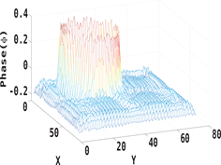
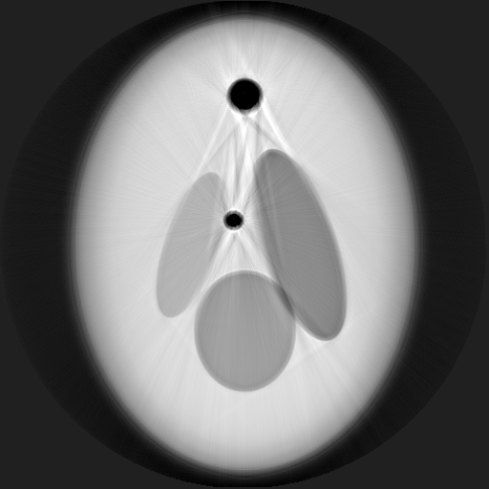
Non-linear phase retrieval Results
Most linear algorithms limited to slowly varying phase
Aim: improvement of resolution (PhD V. Davidoiu)
Frechet derivative of data term
Landweber iteration
Simulated data :2D phase retrieval
Phase tomography
Global improvement but no local
Selection of regularization parameter?

Slide 4
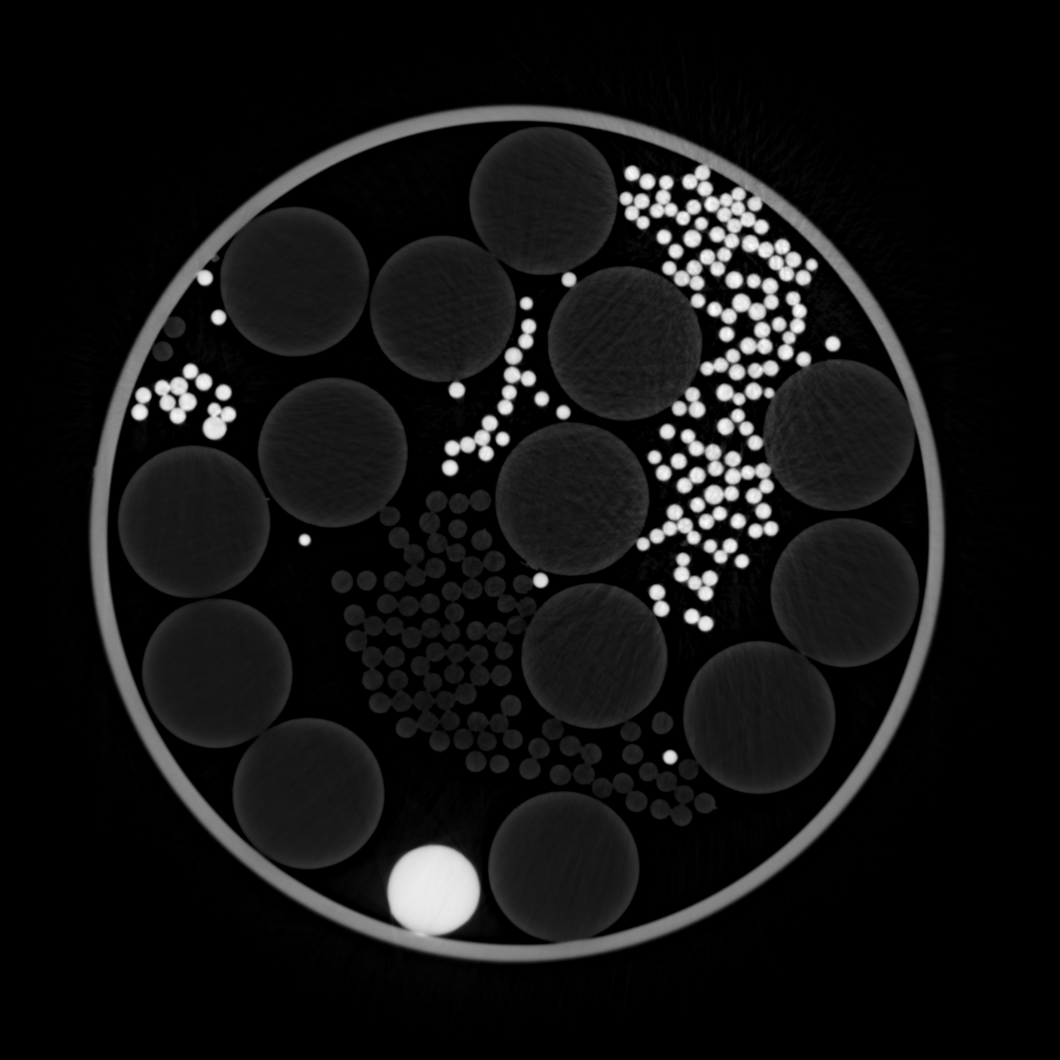
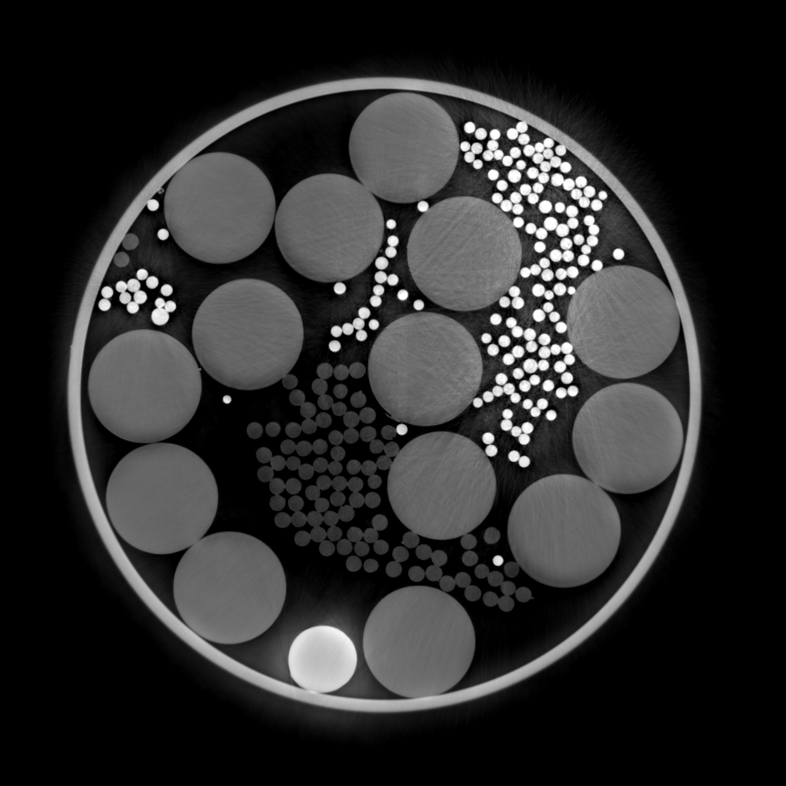
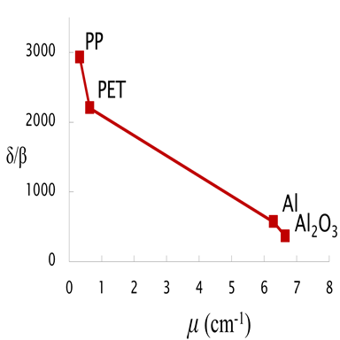
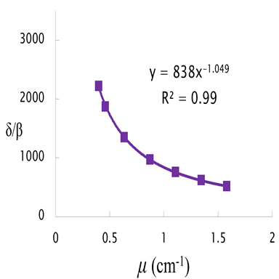
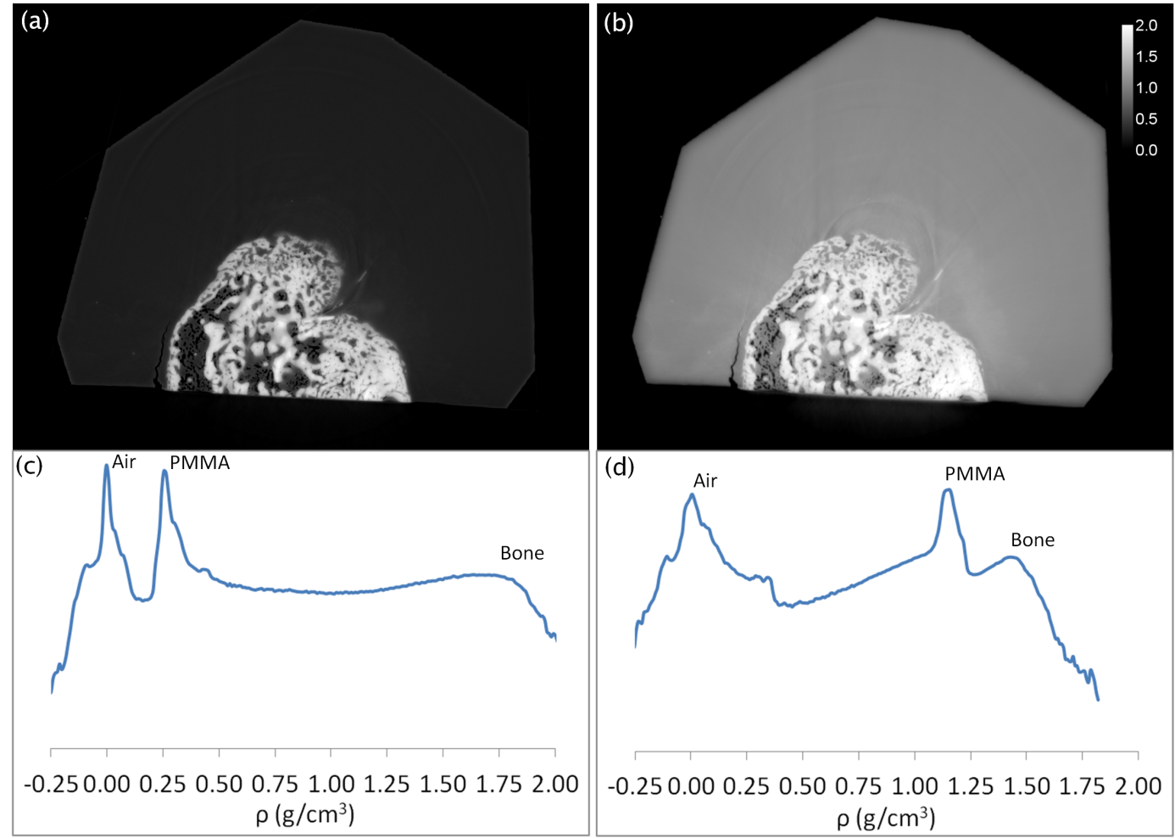
Regularization Results
Aim: reduction of LF artifacts without homogeneity prior
Idea: use a priori information from attenuation
Introduce in object domain
Empirical relationship δ/β as function of μ instead of δβ constant
Experimental data
High accuracy/precision
Loss of resolution - deconvolution
Not possible on truncated data
Mineralization gradient in bone :

Slide 5
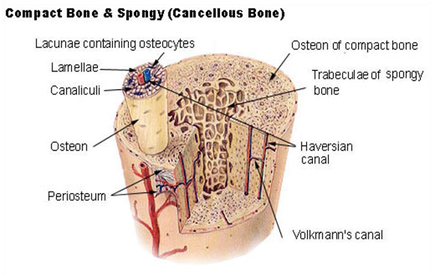
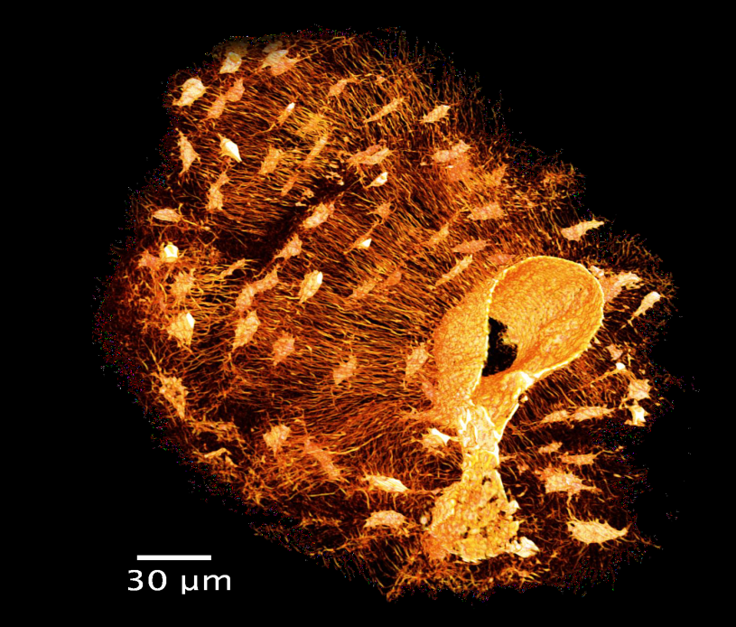
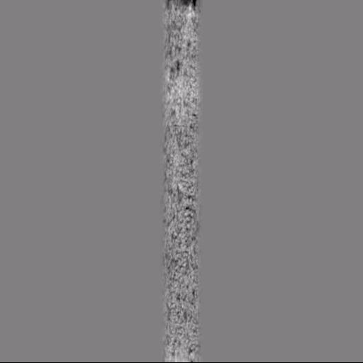
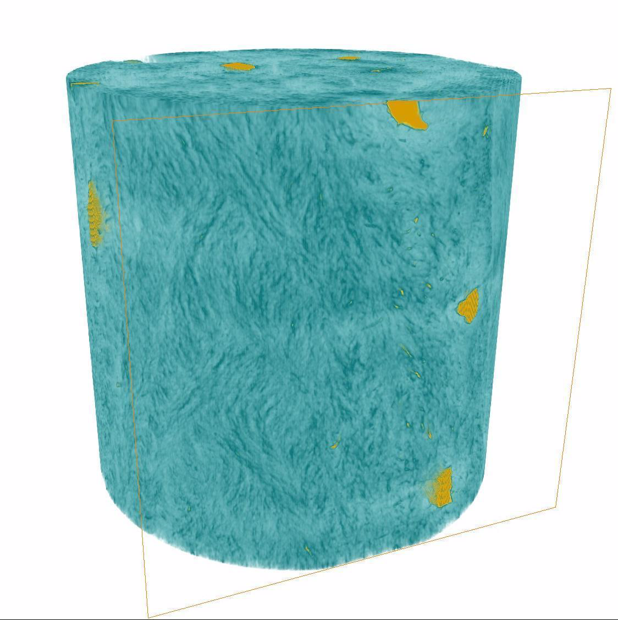
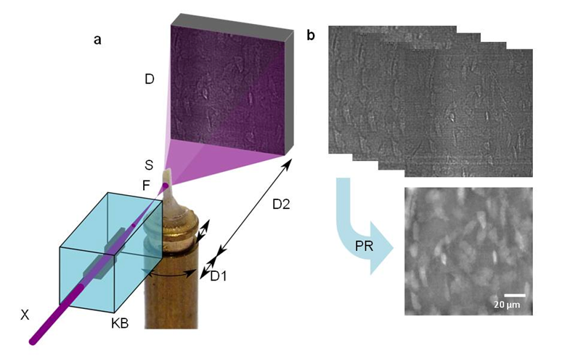
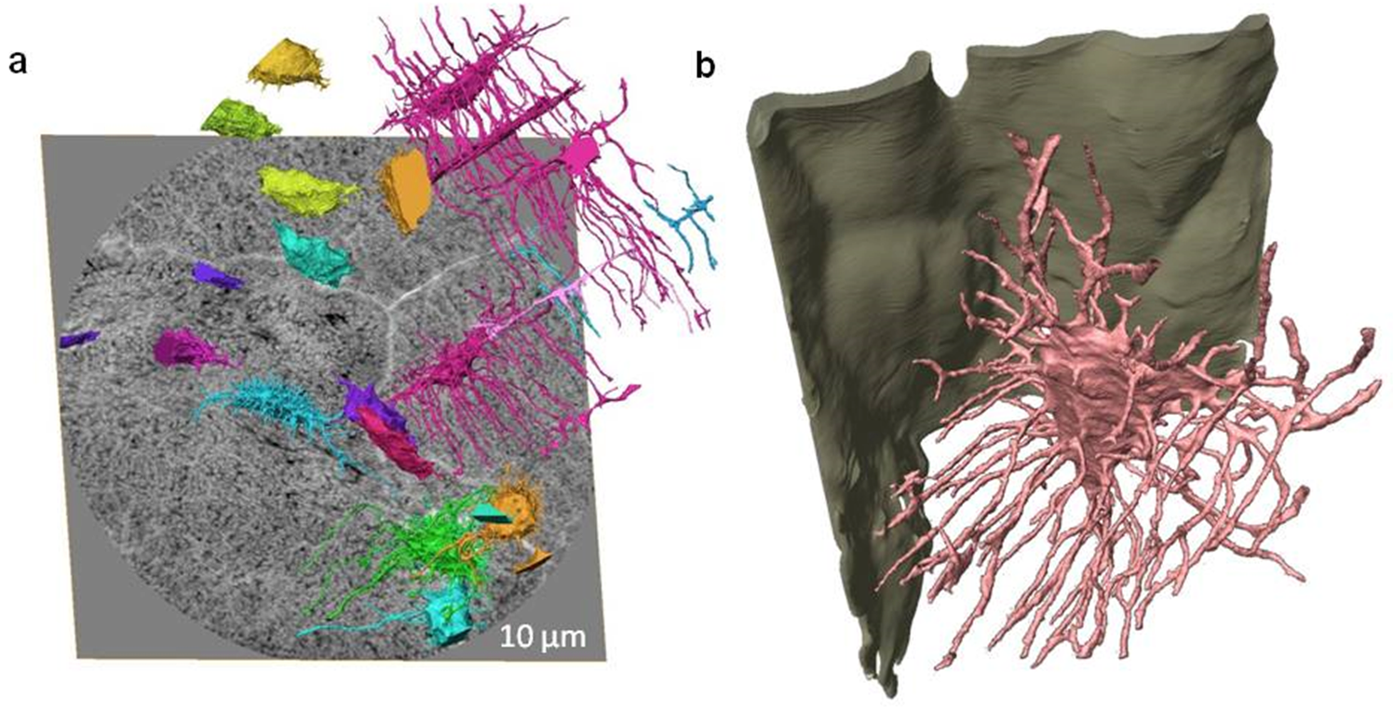
Bone ultrastructure by SR Phase Nano-tomography

Slide 6
Perspectives : X-ray phase CT
3D phase retrieval
  Aim: weaker assumptions on object, avoid need to measure attenuation, simultaneous attenuation and phase retrieval, …
  Idea: other priors in object domain (Piecewise constant, piecewise smooth, parcimony, …)
3D Cell imaging
  Previous imaging of cells in 2D with TEM/SEM
  Our previous work : porous imprint of 3D cells
  Aim: 3D Imaging of bone cells in situ at <50 nm resolution
  Challenges
    sample environment
    Dose deposition

